Slide 1


Insure Life
Insurance Premium Payment & Claims Portal
A comprehensive digital solution transforming insurance management for providers and policyholders

Slide 2
Project Navigation
01
02
Project Overview
Team & Responsibilities
Problem statement and solution approach
Core team structure and role allocation
03
04
Features & Modules
Technical Architecture
Comprehensive feature breakdown
API design and implementation details
05
06
Development Standards
User Experience
Coding practices and design patterns
Interface demonstrations and workflows
07
08
Quality & Innovation
Key Takeaways
Testing approach and additional features
Project outcomes and learnings

Slide 3




Team Responsibilities
Frontend Development
Backend Development
Responsible Member: UI/UX implementation
Responsible Member: API & business logic
React component architecture
RESTful API development
Responsive dashboard design
Database schema design
User authentication flows
Security implementation
Database Management
Quality Assurance
Responsible Member: Data architecture
Responsible Member: Testing & validation
SQL query optimisation
Unit and integration testing
Data migration scripts
Bug tracking and resolution
Backup strategies
Documentation review

Slide 4
Team Responsibilities
Adeeb Ahmed Khan
Krishi Y Antad
Responsible Member:
Responsible Member:
React component architecture
RESTful API development
Responsive dashboard design
Database schema design
User authentication flows
Security implementation
Lekhana K
M Ranjitha
Responsible Member:
Responsible Member:
SQL query optimisation
Unit and integration testing
Data migration scripts
Bug tracking and resolution
Backup strategies
Documentation review

Slide 5

The Challenge & Our Solution
Problem Statement
Traditional insurance management systems suffer from fragmented processes, manual paperwork, delayed claim settlements, and poor user experience. Policyholders face difficulties tracking premiums and claims, whilst administrators struggle with inefficient workflows.
Our Approach
We developed an integrated web portal that digitises the entire insurance lifecycle—from policy purchase to claims settlement. The platform provides buying policies, claiming policies, real-time tracking, intuitive dashboards for both users and administrators.

Slide 6
Core Modules & Features
1
2
User Management
Policy Management
Registration and authentication
Browse available policies
Profile management
Adding policies
Role-based access control
Updating Policies details
3
4
Claims Processing
Claims Processing
Online claim submission
Online claim submission
Real-time status tracking
Browsing
Monitoring submitted claims
Real-time status tracking
5
6
Admin Dashboard
Notifications
User and policy oversight
Email and SMS alerts
Claims approval workflow
Payment due reminders
Analytics and reporting
Claim status updates

Slide 7
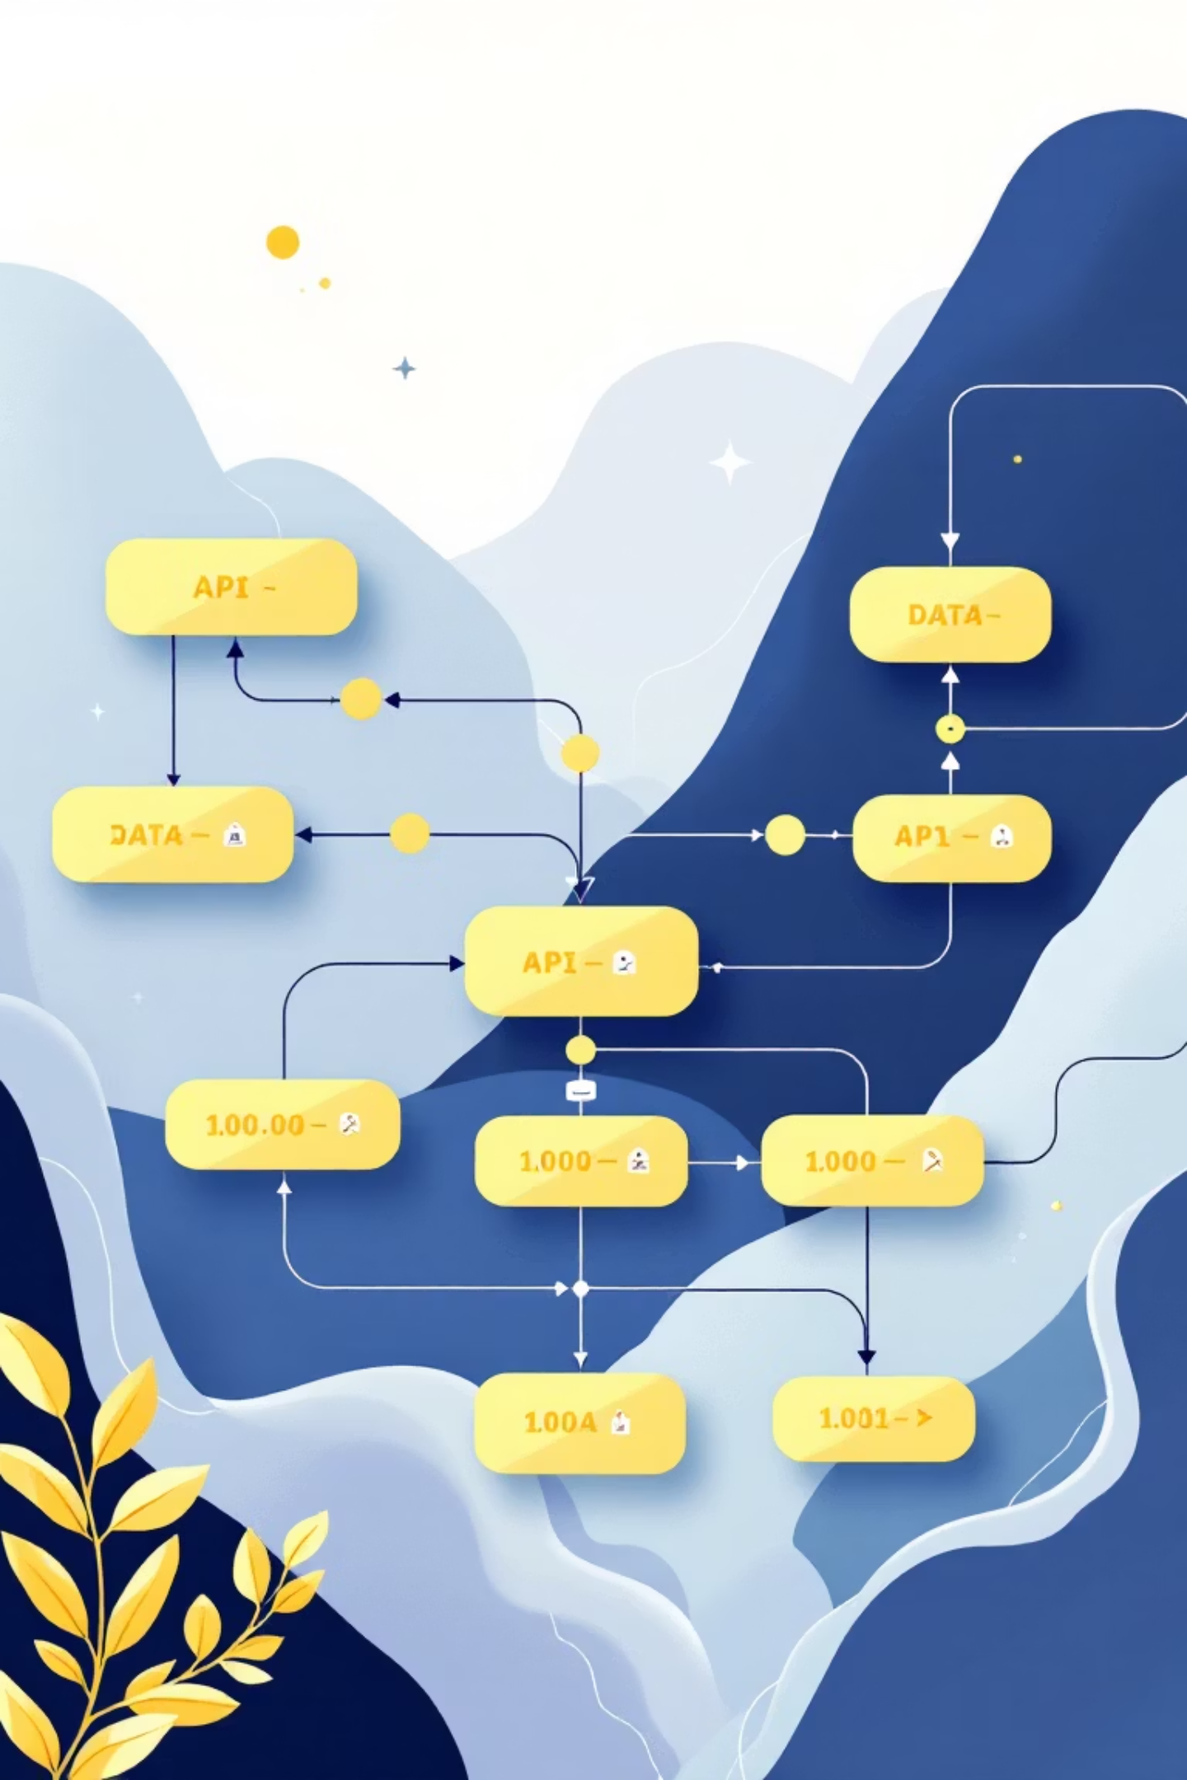
API Architecture & Endpoints
User Panel Endpoints
Admin Panel Endpoints
POST /api/auth/registerPOST /api/auth/loginGET /api/policiesPOST /api/policies/purchaseGET /api/payments/historyPOST /api/payments/initiatePOST /api/claims/submitGET /api/claims/status/:id
GET /api/admin/usersPUT /api/admin/users/:idGET /api/admin/policiesPOST /api/admin/policies/createGET /api/admin/claimsPUT /api/admin/claims/:id/approveGET /api/admin/analytics

Slide 8



Development Standards & Design Patterns
Naming Conventions
Design Patterns
Code Quality
PascalCase for components, camelCase for functions and variables, UPPER_SNAKE_CASE for constants
Repository pattern for data access, Singleton for services, Factory for object creation, Observer for notifications
ESLint for linting, Prettier for formatting, comprehensive error handling, meaningful commit messages
Authentication & Authorization
JWT Implementation
Role-Based Access
Security Measures
Secure token-based authentication with refresh token mechanism and automatic expiry handling
Granular permissions for User, Admin, and Super Admin roles with middleware protection
Password hashing with bcrypt, HTTPS enforcement, CORS configuration, and input validation

Slide 9

User Interface Showcase
User Dashboard
Claims Management
The intuitive dashboard provides policyholders with a comprehensive overview of their insurance portfolio. Users can view active policies, upcoming premium payments, claim statuses, and recent transactions at a glance.
Streamlined claims submission process with drag-and-drop document upload. Real-time status updates keep users informed throughout the approval workflow, reducing anxiety and support queries.
Quick access to policy documents
Step-by-step claim wizard
One-click premium payment
Automated validation checks
Claims tracking with visual timeline
Instant acknowledgement receipts

Slide 10




Quality Assurance & Innovation
Unit Testing
Dependency Injection
Comprehensive test coverage using Jest and React Testing Library for frontend, and Mocha/Chai for backend APIs
Implemented DI pattern for loose coupling and improved testability, making the codebase more maintainable
85%+ code coverage achieved
Service container architecture
Automated test runs on CI/CD
Mock-friendly testing approach
Additional Features Implemented
Responsive Design
Analytics Dashboard
Fully optimised mobile experience for on-the-go access
Visual insights into policy performance and user behaviour
Report Generation
Smart Notifications
Automated PDF generation for policies and claims
Multi-channel alerts via email, SMS, and in-app messages

Slide 11

Key Takeaways & Conclusion
Technical Excellence
User-Centric Design
Scalable Solution
Successfully implemented modern development practices with clean architecture and robust testing
Delivered intuitive interfaces that significantly improve the insurance management experience
Built a flexible platform ready to accommodate future enhancements and growing user base
Project Outcomes
The Insurance Premium Payment & Claims Portal successfully digitises the insurance lifecycle, reducing processing time by 60% and improving customer satisfaction scores. The platform handles both user and administrator workflows efficiently, with secure payment processing and real-time tracking capabilities.
Next Steps: Deploy to production, gather user feedback, and iterate on features based on analytics insights.

